Slide 1
Matrix-vector Multiplication

Slide 2
Chapter Objectives
Review matrix-vector multiplicaiton
Propose replication of vectors
Develop three parallel programs, each based on a different data decomposition

Slide 3
Outline
Sequential algorithm and its complexity
Design, analysis, and implementation of three parallel programs
  Rowwise block striped
  Columnwise block striped
  Checkerboard block

Slide 4
Sequential Algorithm
2
2
2
1
1
1
0
0
0
4
4
4
1
1
1
1
1
1
1
1
1
2
5
5
9
9
3
3
3
2
2
2
1
1
1
1
1
1
3
3
3
3
3
3
3
3
3
3
9
13
14
14
×
=
4
4
4
3
3
3
1
1
1
2
2
2
4
4
4
4
4
4
4
4
4
4
13
17
19
19
3
3
3
0
0
0
2
2
2
0
0
0
1
1
1
1
1
1
1
1
1
3
3
11
11
11

Slide 5
Step-wise optimization
for i = 0 : m – 1
for j = 0 : n – 1
y[i] += A[i, j] * x[j]
 | Load | Store
A | N^2 | 0
x | N^2 | 0
y | N^2 | N^2
Register reuse:
for i = 0 : m – 1
r = y[i];
for j = 0 : n – 1
r += A[i, j] * x[j]
y[i] = r;
 | Load | Store
A | N^2 | 0
x | N^2 | 0
y | N | N

Slide 6
Step-wise optimization
Previous version:
Register blocking:
for i = 0 : 4 : m – 1
r1 = y[i]; r2 = y[i + 1];
r3 = y[i + 2]; r4 = y[i + 3];
for j = 0 : n – 1
r1 += A[i, j] * x[j]
r2 += A[i+2, j] * x[j]
r3 += A[i+3, j] * x[j]
r4 += A[i+4, j] * x[j]
y[i] = r1; y[i+2] = r3;
y[i+1] = r2; y[i+3] = r4;
for i = 0 : m – 1
r = y[i];
for j = 0 : n – 1
r += A[i, j] * x[j]
y[i] = r;
 | Load | Store
A | N^2 | 0
x | N^2 / Ry | 0
y | N | N

Slide 7
Step-wise optimization
Previous version:
Further unroll j-loop to exploit cache locality
for i = 0 : 4 : m – 1
r1 = y[i]; r2 = y[i + 1];
r3 = y[i + 2]; r4 = y[i + 3];
for j = 0 : n – 1
r1 += A[i, j] * x[j]
r2 += A[i+2, j] * x[j]
r3 += A[i+3, j] * x[j]
r4 += A[i+4, j] * x[j]
y[i] = r1; y[i+2] = r3;
y[i+1] = r2; y[i+3] = r4;
for i = 0 : 4 : m – 1
r1 = y[i]; r2 = y[i + 1];
r3 = y[i + 2]; r4 = y[i + 3];
for j = 0 : 4 : n – 1
r1 += A[i, j] * x[j] + …
r2 += A[i+2, j] * x[j] + …
r3 += A[i+3, j] * x[j] + …
r4 += A[i+4, j] * x[j] + …
y[i] = r1; y[i+2] = r3;
y[i+1] = r2; y[i+3] = r4;

Slide 8
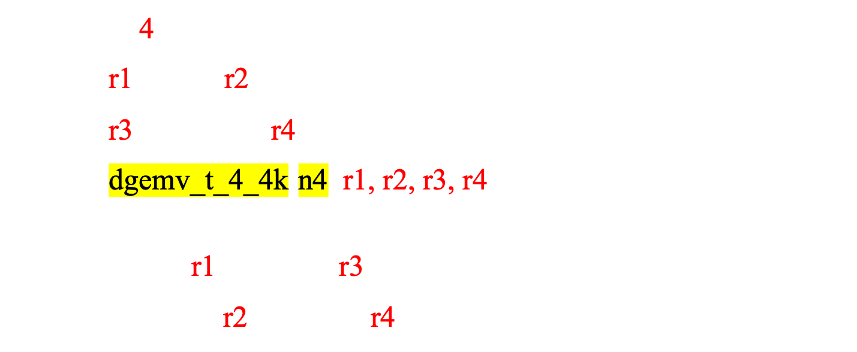
Step-wise optimization
Write into KERNEL form:
Not done yet! Cache blocking:

Slide 9
What did we do before?

Slide 10
What did we do before?

Slide 11
What did we do before?
x may not be resided in cache.

Slide 12
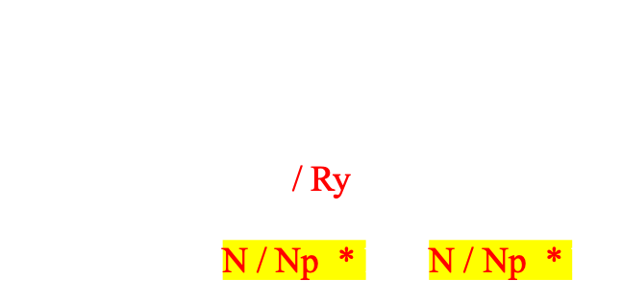
Cache Blocking
Np
If we want to reside x in cache,
The we should have:
Np
Ry
Ry * Np + Ry + Np = Cache
Np = (Cache - Ry) / (Ry + 1)
 | Load | Store
A | N^2 | 0
x | N^2 / Ry | 0
y | N | N

Slide 13
Storing Vectors
Divide vector elements among processes
Replicate vector elements
Vector replication acceptable because vectors have only n elements, versus n² elements in matrices

Slide 14
Rowwise Block Striped Matrix
Partitioning through domain decomposition
Primitive task associated with
  Row of matrix
  Entire vector

Slide 15
Phases of Parallel Algorithm
b
Inner product computation
Row i of A
b
Row i of A
c_{i}
b
c
Row i of A
All-gather communication

Slide 16
Agglomeration and Mapping
Static number of tasks
Regular communication pattern (all-gather)
Computation time per task is constant
Strategy:
  Agglomerate groups of rows
  Create one task per MPI process

Slide 17
Complexity Analysis
Sequential algorithm complexity: Θ(n²)
Parallel algorithm computational complexity: Θ(n²/p)
Communication complexity of all-gather: Θ(log p + n)
Overall complexity: Θ(n²/p + log p)

Slide 18
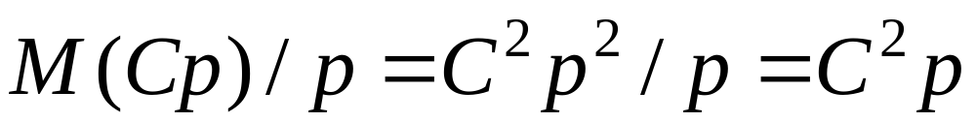
Isoefficiency Analysis
Sequential time complexity: Θ(n²)
Only parallel overhead is all-gather
  When n is large, message transmission time dominates message latency
  Parallel communication time: Θ(n)
n² ≥ Cpn ⇒ n ≥ Cp and M(n) = n²
System is not highly scalable

Slide 19
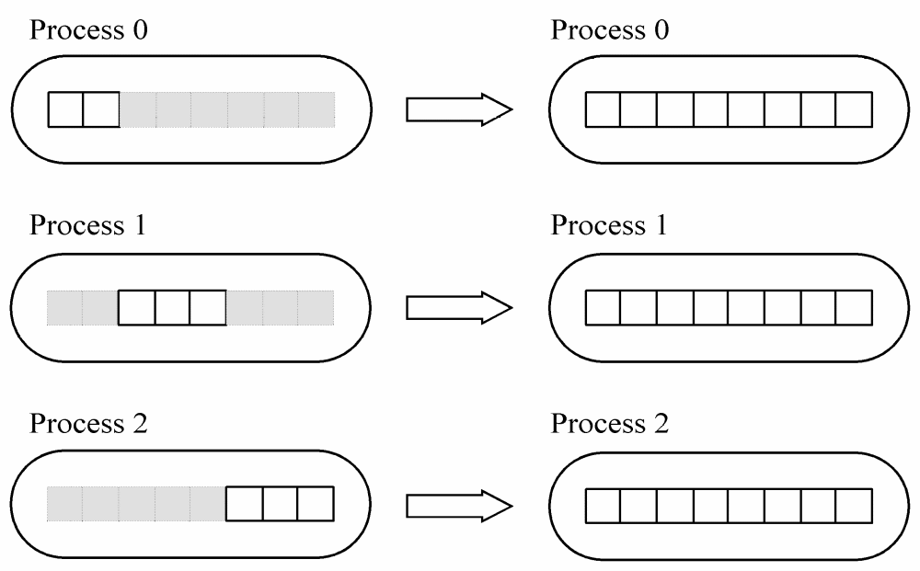
Block-to-replicated Transformation

Slide 20
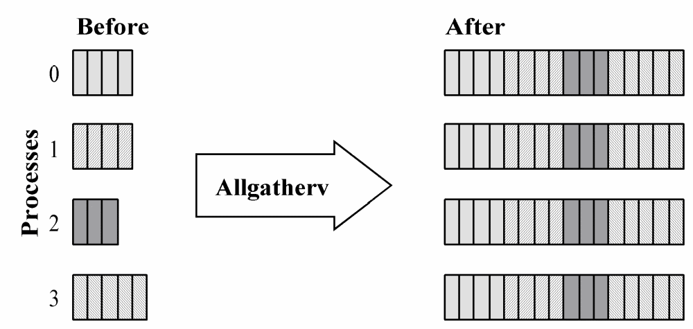
MPI_Allgatherv

Slide 21
MPI_Allgatherv
int MPI_Allgatherv (
void *send_buffer,
int send_cnt,
MPI_Datatype send_type,
void *receive_buffer,
int *receive_cnt,
int *receive_disp,
MPI_Datatype receive_type,
MPI_Comm communicator)

Slide 22
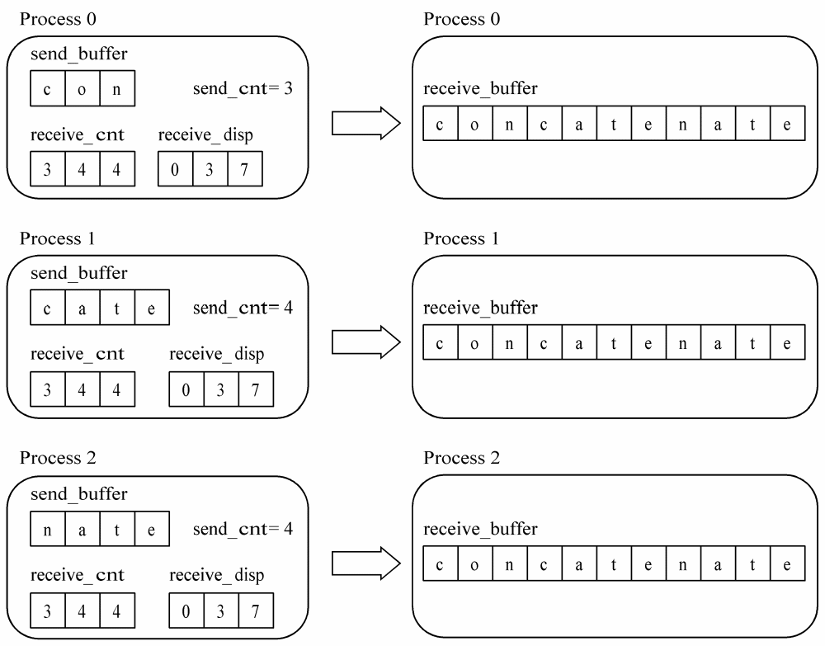
MPI_Allgatherv in Action

Slide 23
Benchmarking Results
 | Execution Time (msec)
p | Predicted | Actual | Speedup | Mflops
1 | 63.4 | 63.4 | 1.00 | 31.6
2 | 32.4 | 32.7 | 1.94 | 61.2
3 | 22.3 | 22.7 | 2.79 | 88.1
4 | 17.0 | 17.8 | 3.56 | 112.4
5 | 14.1 | 15.2 | 4.16 | 131.6
6 | 12.0 | 13.3 | 4.76 | 150.4
7 | 10.5 | 12.2 | 5.19 | 163.9
8 | 9.4 | 11.1 | 5.70 | 180.2
16 | 5.7 | 7.2 | 8.79 | 277.8

Slide 24
Columnwise Block Striped Matrix
Partitioning through domain decomposition
Task associated with
  Column of matrix
  Vector element

Slide 25
Matrix-Vector Multiplication
c₀ = a_{0,0} b₀ + a_{0,1} b₁ + a_{0,2} b₂ + a_{0,3} b₃ + a_{4,4} b₄
c₁ = a_{1,0} b₀ + a_{1,1} b₁ + a_{1,2} b₂ + a_{1,3} b₃ + a_{1,4} b₄
c₂ = a_{2,0} b₀ + a_{2,1} b₁ + a_{2,2} b₂ + a_{2,3} b₃ + a_{2,4} b₄
c₃ = a_{3,0} b₀ + a_{3,1} b₁ + a_{3,2} b₂ + a_{3,3} b₃ + b_{3,4} b₄
c₄ = a_{4,0} b₀ + a_{4,1} b₁ + a_{4,2} b₂ + a_{4,3} b₃ + a_{4,4} b₄
Proc 4
Proc 3
Proc 2
Processor 1’s initial computation
Processor 0’s initial computation

Slide 26
All-to-all Exchange (Before)
P0
P1
P2
P3
P4

Slide 27
All-to-all Exchange (After)
P0
P1
P2
P3
P4

Slide 28
Phases of Parallel Algorithm
Multiplications
b
b
~c
Column i of A
Column i of A
All-to-all exchange
b
c
b
~c
Column i of A
Column i of A
Reduction

Slide 29
Agglomeration and Mapping
Static number of tasks
Regular communication pattern (all-to-all)
Computation time per task is constant
Strategy:
  Agglomerate groups of columns
  Create one task per MPI process

Slide 30
Complexity Analysis
Sequential algorithm complexity: Θ(n²)
Parallel algorithm computational complexity: Θ(n²/p)
Communication complexity of all-to-all: Θ(p + n)
Overall complexity: Θ(n²/p + n + p)

Slide 31
Isoefficiency Analysis
Sequential time complexity: Θ(n²)
Only parallel overhead is all-to-all
  When n is large, message transmission time dominates message latency
  Parallel communication time: Θ(n)
n² ≥ Cpn ⇒ n ≥ Cp
Scalability function same as rowwise algorithm: C²p

Slide 32
Reading a Block-Column Matrix
File

Slide 33
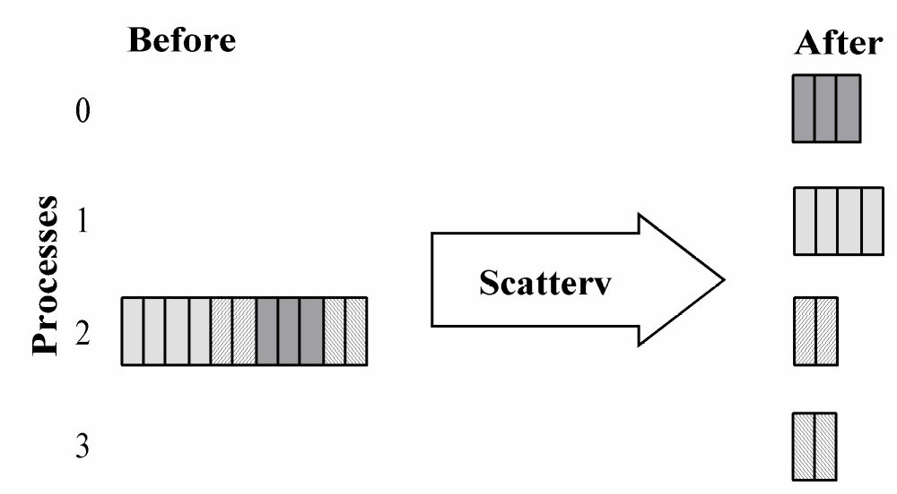
MPI_Scatterv

Slide 34
Printing a Block-Column Matrix
Data motion opposite to that we did when reading the matrix
Replace “scatter” with “gather”
Use “v” variant because different processes contribute different numbers of elements

Slide 35
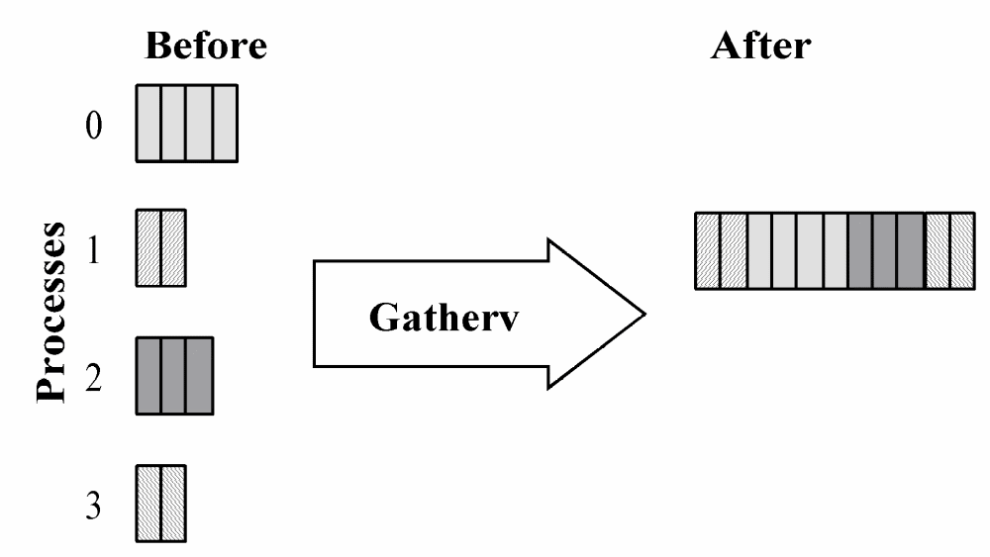
Function MPI_Gatherv

Slide 36
Benchmarking Results
 | Execution Time (msec)
p | Predicted | Actual | Speedup | Mflops
1 | 63.4 | 63.8 | 1.00 | 31.4
2 | 32.4 | 32.9 | 1.92 | 60.8
3 | 22.2 | 22.6 | 2.80 | 88.5
4 | 17.2 | 17.5 | 3.62 | 114.3
5 | 14.3 | 14.5 | 4.37 | 137.9
6 | 12.5 | 12.6 | 5.02 | 158.7
7 | 11.3 | 11.2 | 5.65 | 178.6
8 | 10.4 | 10.0 | 6.33 | 200.0
16 | 8.5 | 7.6 | 8.33 | 263.2

Slide 37
Checkerboard Block Decomposition
Associate primitive task with each element of the matrix A
Each primitive task performs one multiply
Agglomerate primitive tasks into rectangular blocks
Processes form a 2-D grid
Vector b distributed by blocks among processes in first column of grid

Slide 38
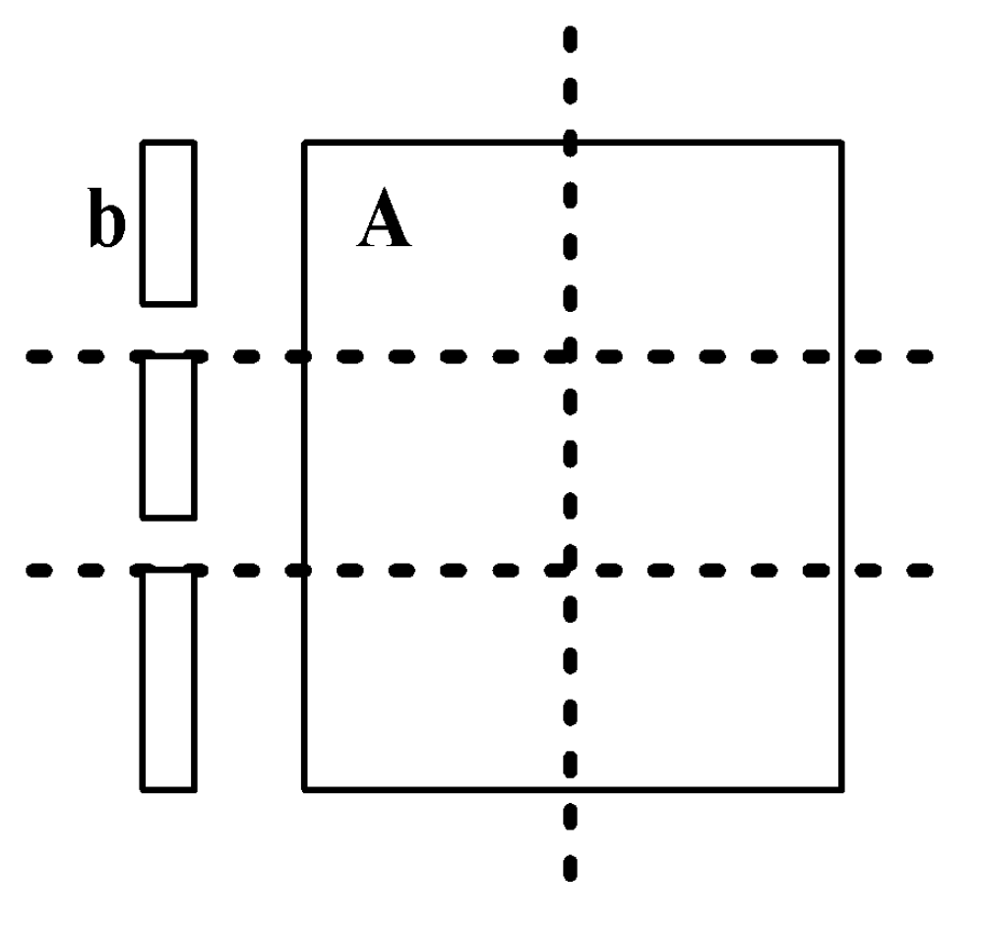
Tasks after Agglomeration

Slide 39
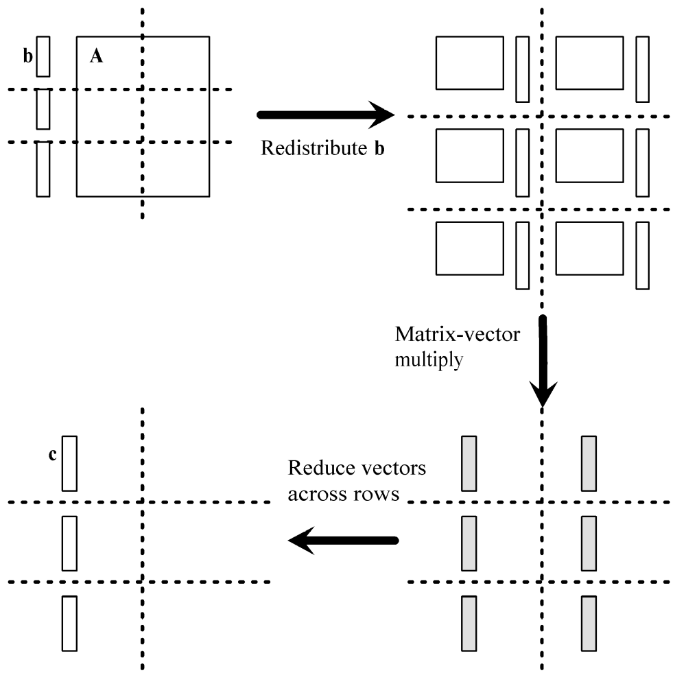
Algorithm’s Phases

Slide 40
Redistributing Vector b
Step 1: Move b from processes in first column to processes in first row
  If p square
    First column/first row processes send/receive portions of b
  If p not square
    Gather b on process 0, 0
    Process 0, 0 scatter to first row procs
Step 2: First row processes broadcast within columns

Slide 41
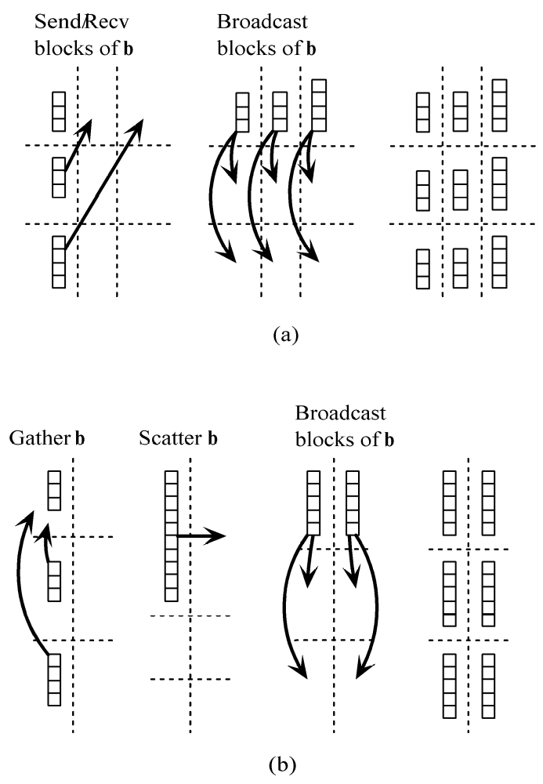
Redistributing Vector b
When p is a square number
When p is not a square number

Slide 42
Complexity Analysis
Assume p is a square number
  If grid is 1 × p, devolves into columnwise block striped
  If grid is p × 1, devolves into rowwise block striped

Slide 43
Complexity Analysis (continued)
Each process does its share of computation: Θ(n²/p)
Redistribute b: Θ(n / √p + log p(n / √p )) = Θ(n log p / √p)
Reduction of partial results vectors:
Θ(n log p / √p)
Overall parallel complexity:
Θ(n²/p + n log p / √p)

Slide 44
Isoefficiency Analysis
Sequential complexity: Θ(n²)
Parallel communication complexity:
Θ(n log p / √p)
Isoefficiency function:
n² ≥ Cn √p log p ⇒ n ≥ C √p log p
This system is much more scalable than the previous two implementations

Slide 45
Creating Communicators
Want processes in a virtual 2-D grid
Create a custom communicator to do this
Collective communications involve all processes in a communicator
We need to do broadcasts, reductions among subsets of processes
We will create communicators for processes in same row or same column

Slide 46
What’s in a Communicator?
Process group
Context
Attributes
  Topology (lets us address processes another way)
  Others we won’t consider

Slide 47
Creating 2-D Virtual Grid of Processes
MPI_Dims_create
  Input parameters
    Total number of processes in desired grid
    Number of grid dimensions
  Returns number of processes in each dim
MPI_Cart_create
  Creates communicator with cartesian topology

Slide 48
MPI_Dims_create
int MPI_Dims_create (
int nodes,
/* Input - Procs in grid */
int dims,
/* Input - Number of dims */
int *size)
/* Input/Output - Size of
each grid dimension */

Slide 49
MPI_Cart_create
int MPI_Cart_create (
MPI_Comm old_comm, /* Input - old communicator */
int dims, /* Input - grid dimensions */
int *size, /* Input - # procs in each dim */
int *periodic,
/* Input - periodic[j] is 1 if dimension j
wraps around; 0 otherwise */
int reorder,
/* 1 if process ranks can be reordered */
MPI_Comm *cart_comm)
/* Output - new communicator */

Slide 50
Using MPI_Dims_create and MPI_Cart_create
MPI_Comm cart_comm;
int p;
int periodic[2];
int size[2];
...
size[0] = size[1] = 0;
MPI_Dims_create (p, 2, size);
periodic[0] = periodic[1] = 0;
MPI_Cart_create (MPI_COMM_WORLD, 2, size,
1, &cart_comm);

Slide 51
Useful Grid-related Functions
MPI_Cart_rank
  Given coordinates of process in Cartesian communicator, returns process rank
MPI_Cart_coords
  Given rank of process in Cartesian communicator, returns process’ coordinates

Slide 52
Header for MPI_Cart_rank
int MPI_Cart_rank (
MPI_Comm comm,
/* In - Communicator */
int *coords,
/* In - Array containing process’
grid location */
int *rank)
/* Out - Rank of process at
specified coords */

Slide 53
Header for MPI_Cart_coords
int MPI_Cart_coords (
MPI_Comm comm,
/* In - Communicator */
int rank,
/* In - Rank of process */
int dims,
/* In - Dimensions in virtual grid */
int *coords)
/* Out - Coordinates of specified
process in virtual grid */

Slide 54
MPI_Comm_split
Partitions the processes of a communicator into one or more subgroups
Constructs a communicator for each subgroup
Allows processes in each subgroup to perform their own collective communications
Needed for columnwise scatter and rowwise reduce

Slide 55
Header for MPI_Comm_split
int MPI_Comm_split (
MPI_Comm old_comm,
/* In - Existing communicator */
int partition, /* In - Partition number */
int new_rank,
/* In - Ranking order of processes
in new communicator */
MPI_Comm *new_comm)
/* Out - New communicator shared by
processes in same partition */

Slide 56
Example: Create Communicators for Process Rows
MPI_Comm grid_comm; /* 2-D process grid */
Int grid_coords[2];
/* Location of process in grid */
MPI_Comm row_comm;
/* Processes in same row */
MPI_Comm_split (grid_comm, grid_coords[0],
grid_coords[1], &row_comm);

Slide 57
Run-time Expression
Computational time: χ ⎡n/√p⎤ ⎡n/√p⎤
Suppose p a square number
Redistribute b
  Send/recv: λ + 8 ⎡n/√p⎤ / β
  Broadcast: log √p ( λ + 8 ⎡n/√p⎤ / β)
Reduce partial results:
log √p ( λ + 8 ⎡n/√p⎤ / β)

Slide 58
Benchmarking
Procs | Predicted(msec) | Actual (msec) | Speedup | Megaflops
1 | 63.4 | 63.4 | 1.00 | 31.6
4 | 17.8 | 17.4 | 3.64 | 114.9
9 | 9.7 | 9.7 | 6.53 | 206.2
16 | 6.2 | 6.2 | 10.21 | 322.6

Slide 59
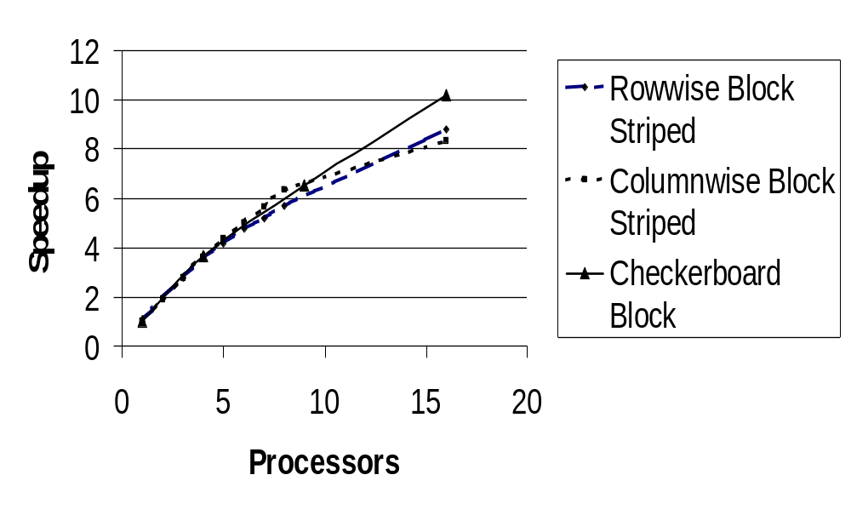
Comparison of Three Algorithms

Slide 60
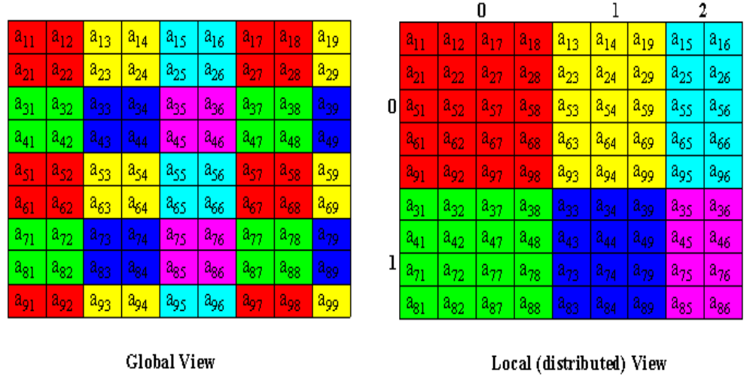
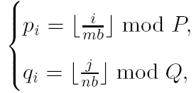
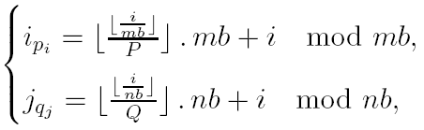
ScaLAPACK: 2D Block Cyclic Matrix Distribution

Slide 61
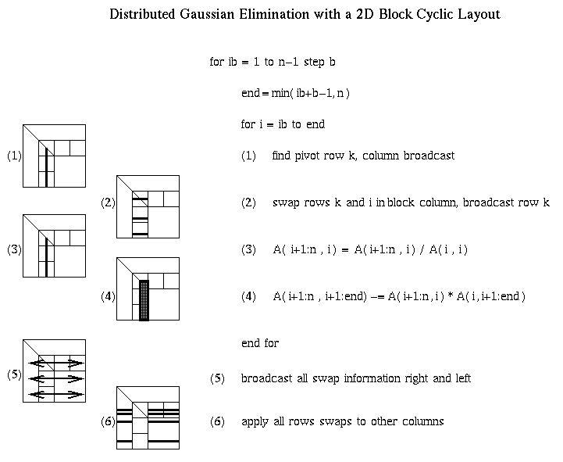
Distributed GE with a 2D Block Cyclic Layout

Slide 62
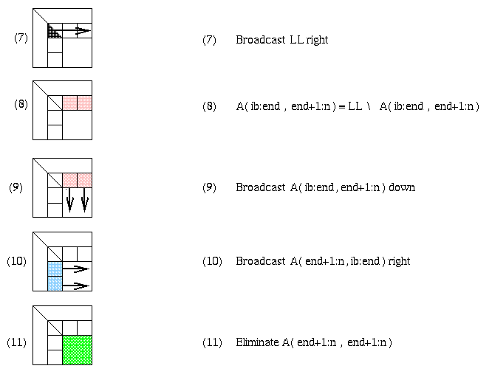
Matrix multiply of
green = green - blue * pink

